Slide 1
Clustering Project

Slide 2
Overview
Project Goals
Work Flow
Results

Slide 3
Project Goal
Utilize the given financial Data
Create clusters based on
Demographic
Banking behavior
Visualize the clusters
Visualize segmentations
Visualize in 2D how our clusters are evolving in each iteration of KMeans

Slide 4
Use case
Fraud detection
Risk assessment
Loans
mortgages
credit risk
Targeted Customer Service

Slide 5
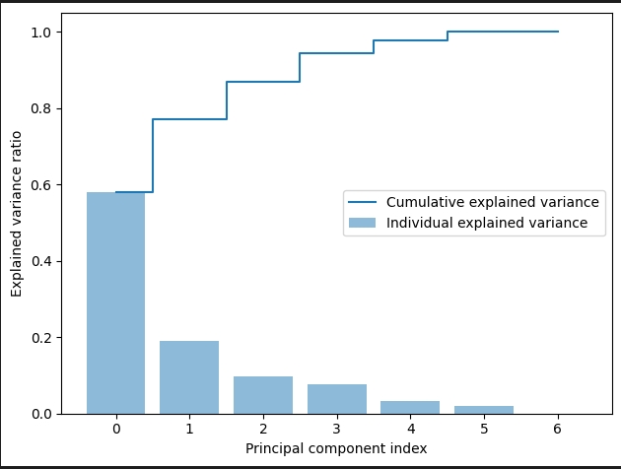
Results – Demographics - EDA

Slide 6
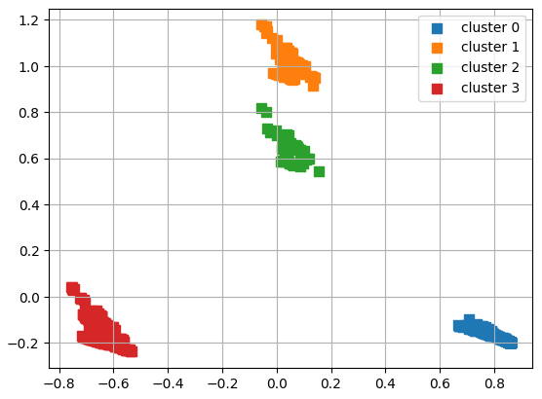
Results - Demographics

Slide 7
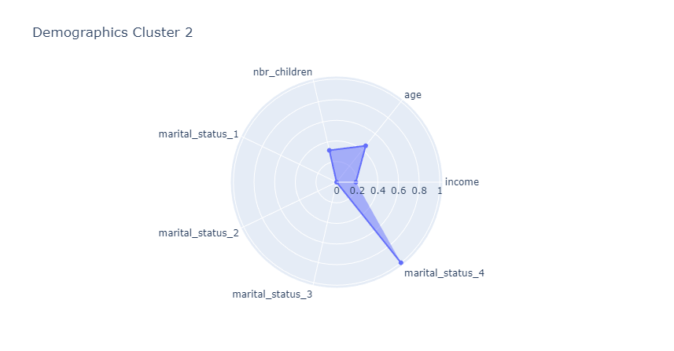
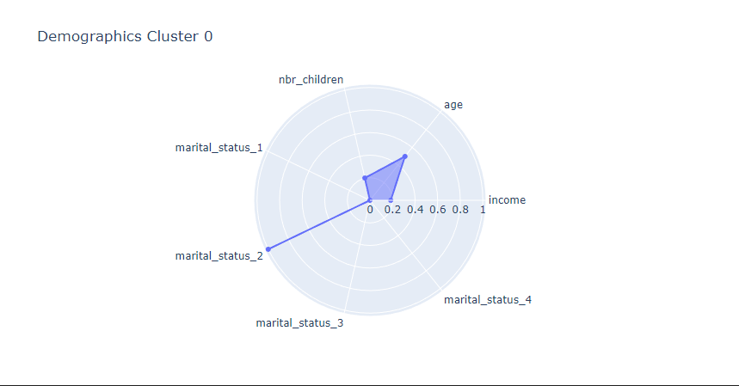
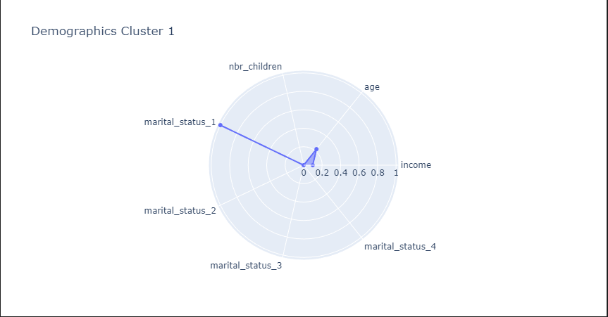
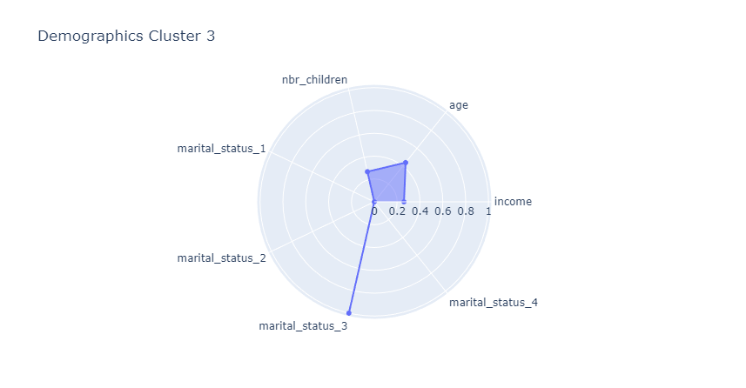
Results - demographics

